Slide 1
Energy Efficiency of Residential Buildings as a Function of Building Characteristics
Amanda Bootz
Master of Business Administration
Prathibha Boyapalli
M.S. Computer Science and Information Systems
Rhys Barrie
M.S. Computer Science and Information Systems

Slide 2

Problem Definition
How does a residential building’s design characteristics impact its energy efficiency?
Heating and cooling loads are a measure of the energy that is required to maintain a comfortable temperature in an indoor space.
By understanding how design characteristics impact a residential building’s energy efficiency, an architect or builder would be able to make data-driven design decisions.

Slide 3
Project Goals
Our project sets out to answer the following questions:
Which design characteristics have the most significant impact on heating and cooling load?
What is the most energy efficient residential building design?
What impact do each of the design characteristics have on heating and cooling load?
How can optimizing features like glazing area, building compactness, and orientation help reduce a building's overall energy consumption?
What kinds of trade-offs exist between different design elements, such as balancing the amount of glazing area with wall insulation, and how do these trade-offs impact energy efficiency?

Slide 4
Dataset Overview
Dataset sourced from “Accurate quantitative estimation of energy performance of residential buildings using statistical machine learning tools” by Tsanas and Xifara
Measures heating and cooling loads as a function of various building design parameters
Dataset assumptions:
All buildings have a volume of 771.75 cubic meters
Buildings are located in Athens, Greece
Residential occupancy of 7 people, with sedentary occupancy
Buildings constructed with common building materials

Slide 5
Dataset Overview
Independent Variables
Relative Compactness
Continuous Ratio (skew 0.50)
Surface Area
Continuous Ratio (skew -0.12)
Wall Area
Continuous Ratio (skew 0.53)
Roof Area
Continuous Ratio (skew -0.16)
Overall Height
Continuous Ratio (skew 0.00)
Represents single story (3.5 meter) and two-story (7 meter) buildings
Orientation
Nominal / Categorical
2 = North, 3 = East, 4 = South, 5 = West
Glazing Area
Continuous Ratio (skew -0.06)
Measured as percentage of the floor area - 0%, 10%, 25%, and 40%
Glazing Area Distribution
Nominal / Categorical
0 = no glazing
1 = uniform distribution (25% per side)
2 = 55% north, 15% other
3 = 55% east, 15% other
4 = 55% south, 15% other
5 = 55% west, 15% other
Dependent Variables
Heating Load
Continuous Ratio (skew 0.36)
Cooling Load
Continuous Ratio (skew 0.40)

Slide 6
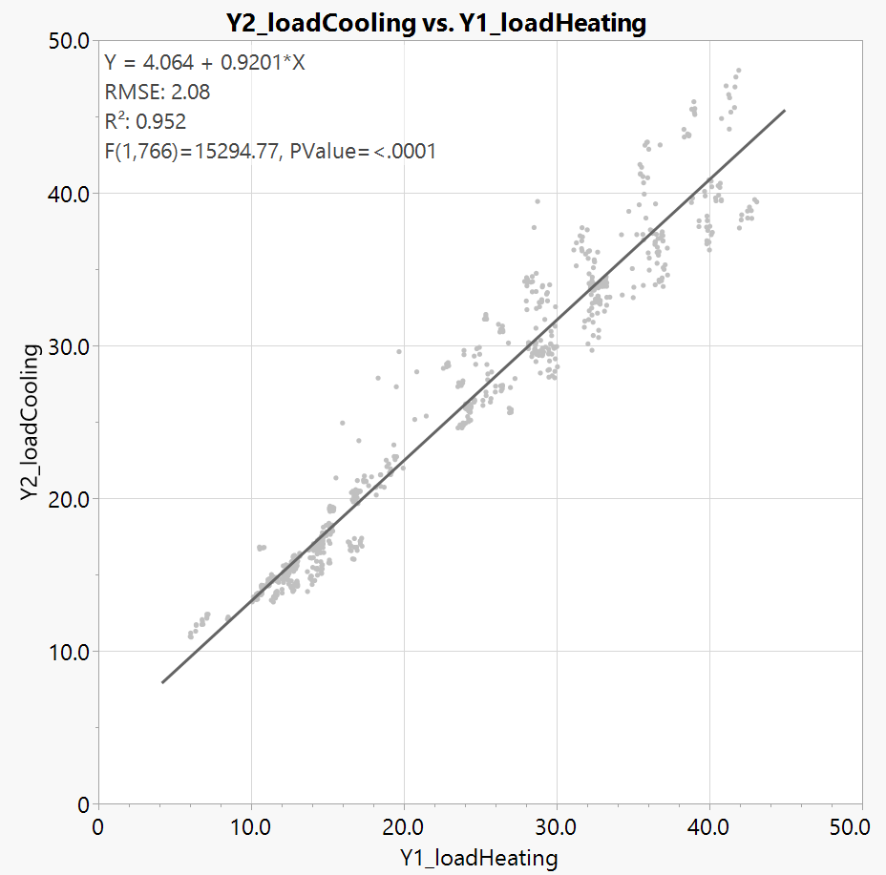
Initial Observations
Heating and cooling loads are strongly correlated
Don’t appear to significantly diverge for any of the independent variables
Cooling loads are generally higher than heating loads
Aligns with the assumption that all simulated structures are located in Greece, with hot summers and mild winters

Slide 7
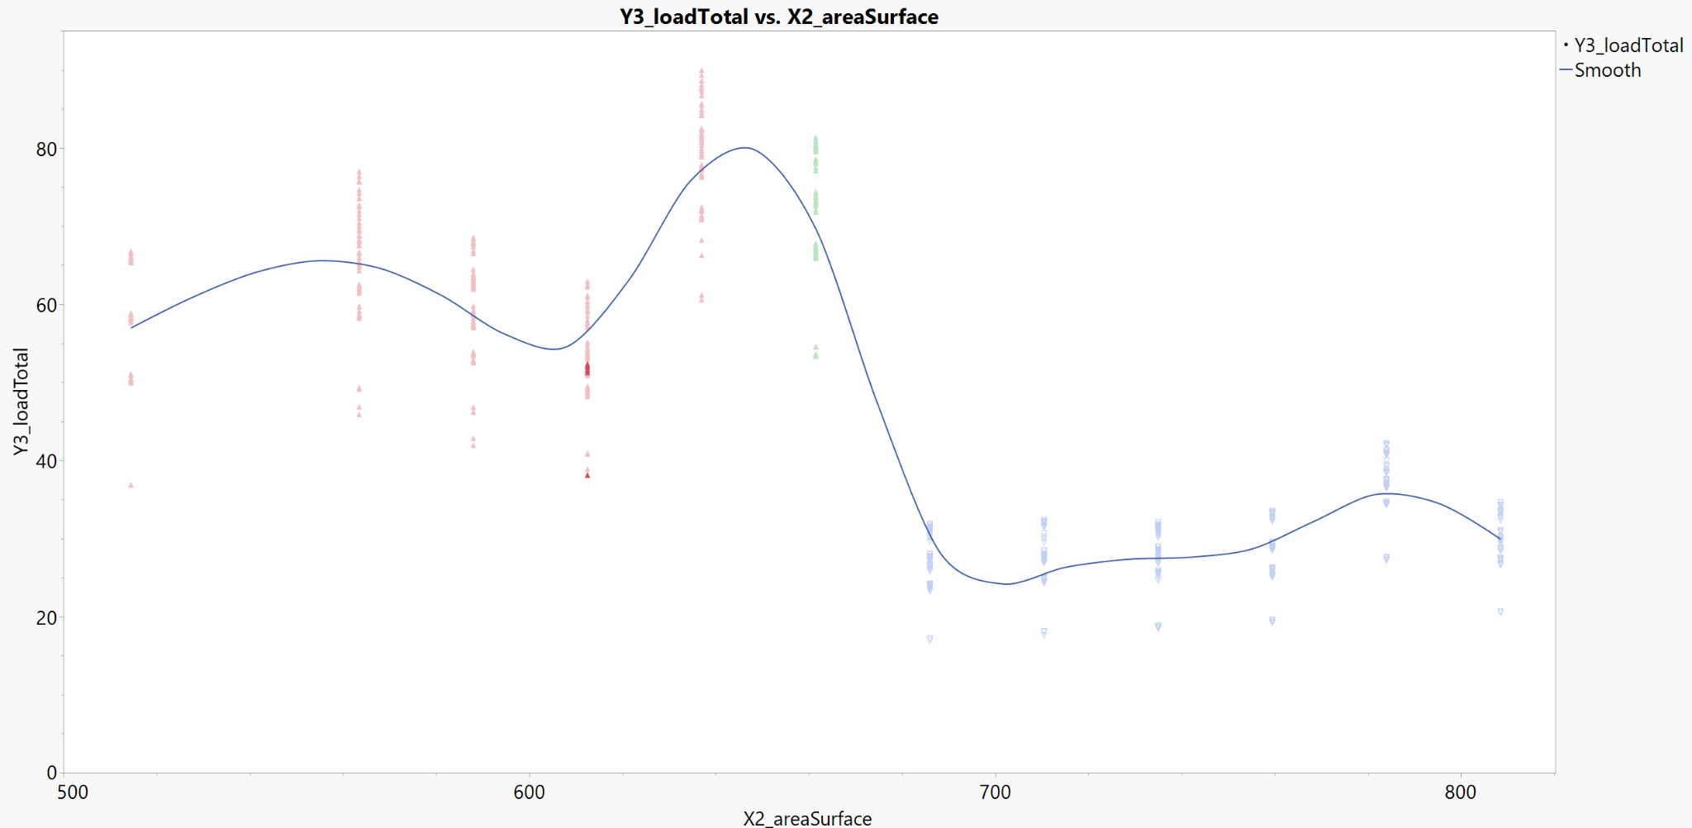
Initial Observations
Orientation of the building and orientation of the glazing do not appear to have significant differences in heating and cooling loads
i.e. sunlight direction doesn’t appear to matter
Taller homes have significantly higher heating and cooling loads for the same building volume.
Similarly, larger footprint homes appear to have lower heating and cooling loads.

Slide 8
Cluster Analysis Model

Slide 9
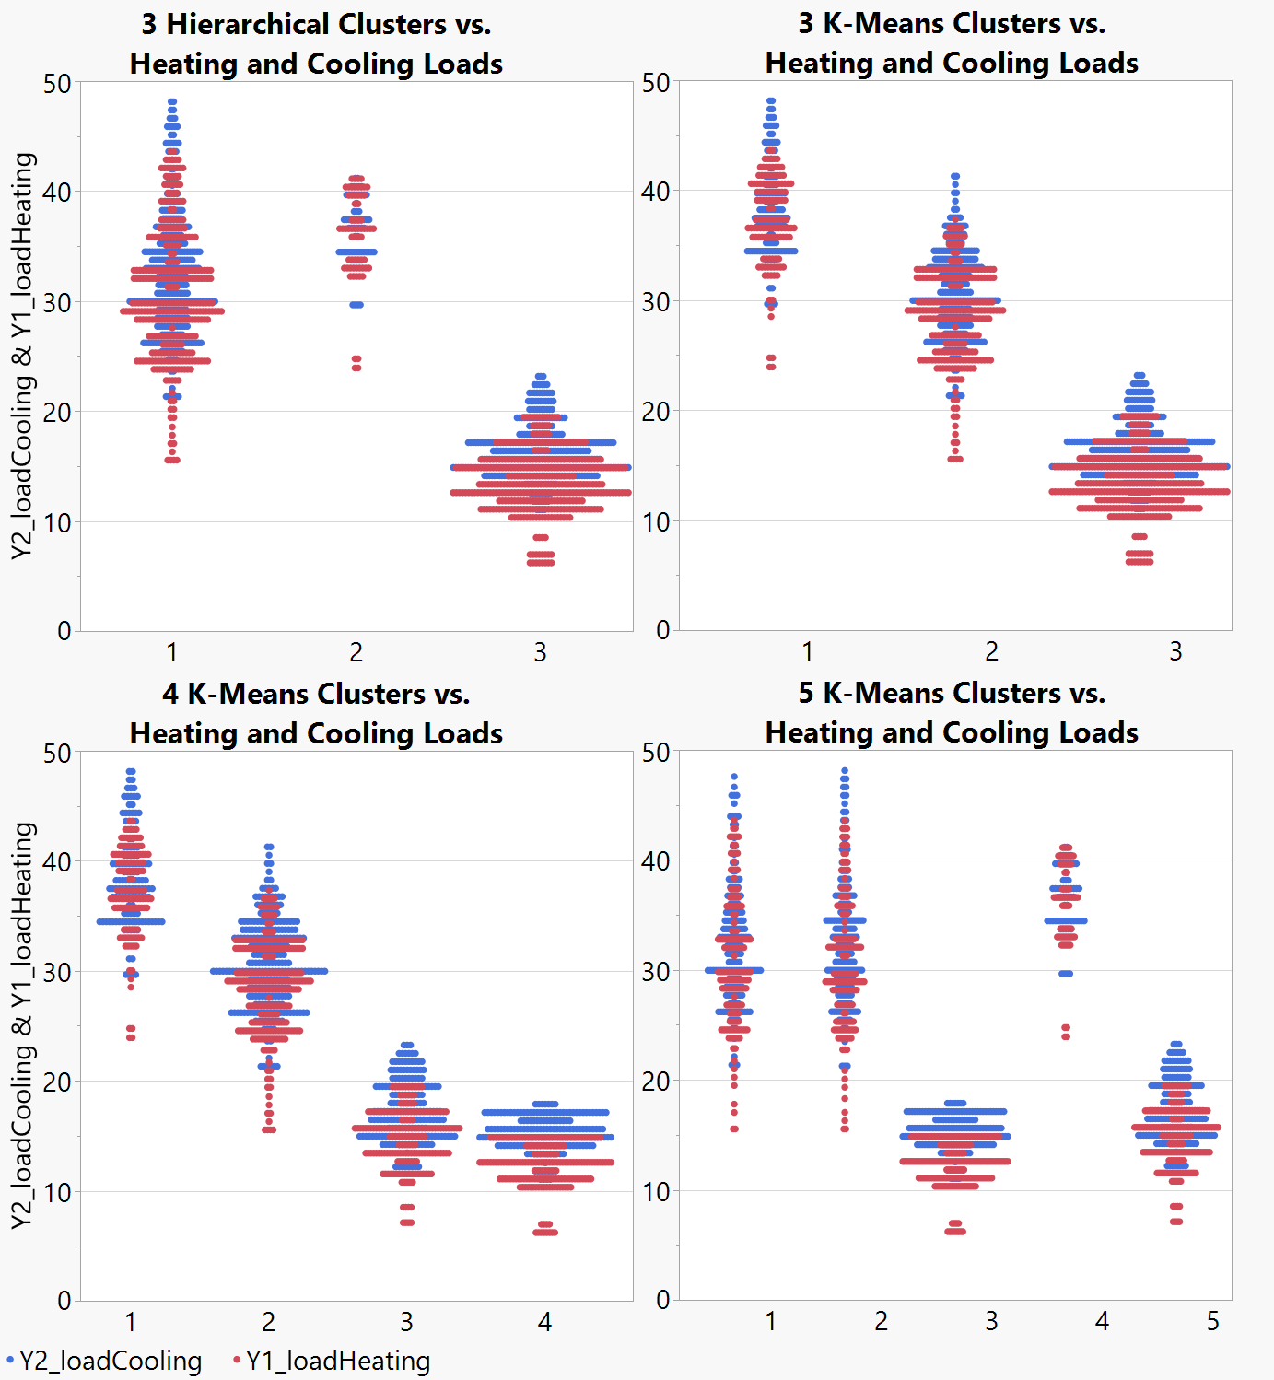
Cluster Analysis Model
Analyzed the building characteristics against the heating and cooling loads to determine which characteristics had the most distinct impact on the loads.
Results for each of the models were compared to determine which one was the most effective to analyze our data.

Slide 10
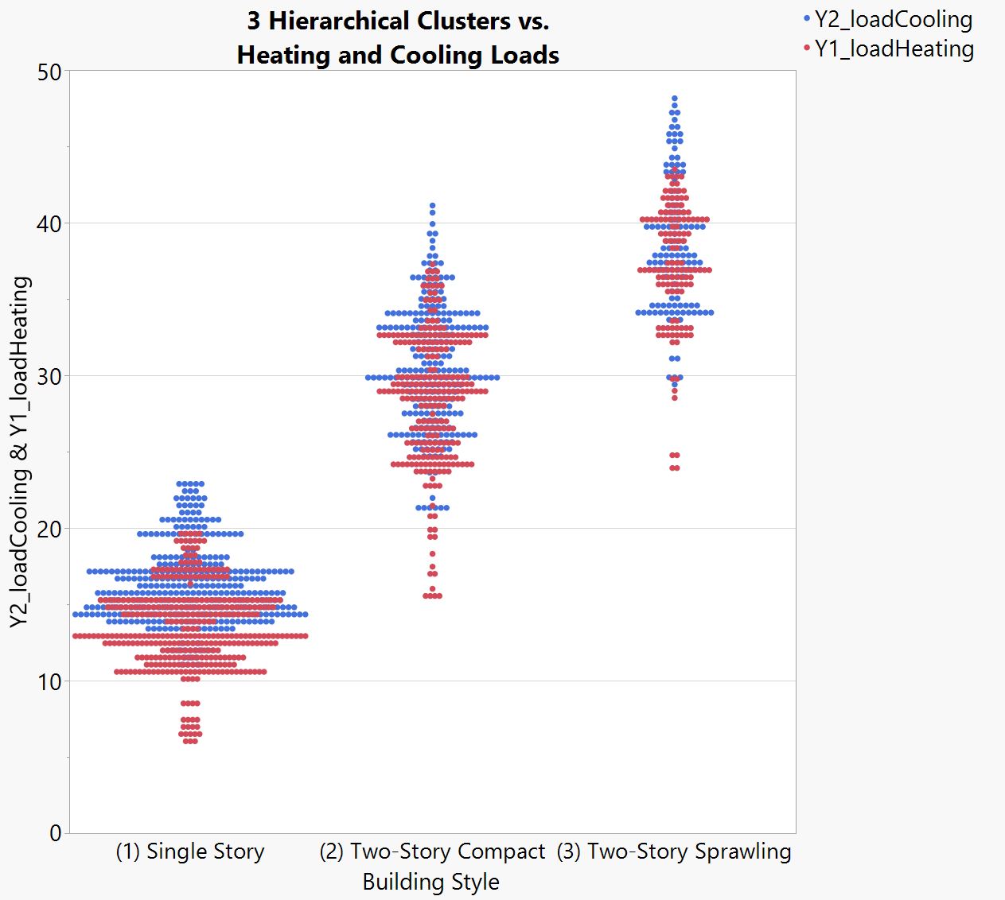
Cluster Analysis Model
Based on these results, the 3 clusters k-means had clear distinction between low, medium, and high loads.
Identification of each cluster are listed below:
Cluster 1 = single story buildings, resulting in low heating/cooling loads
Cluster 2 = compact two-story buildings, resulting in medium heating/cooling loads
Cluster 3 = less-compact two-story buildings, resulting in high heating/cooling loads

Slide 11
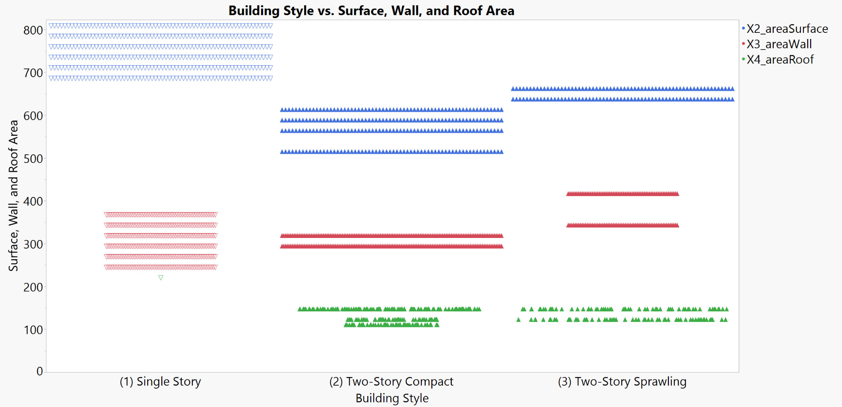
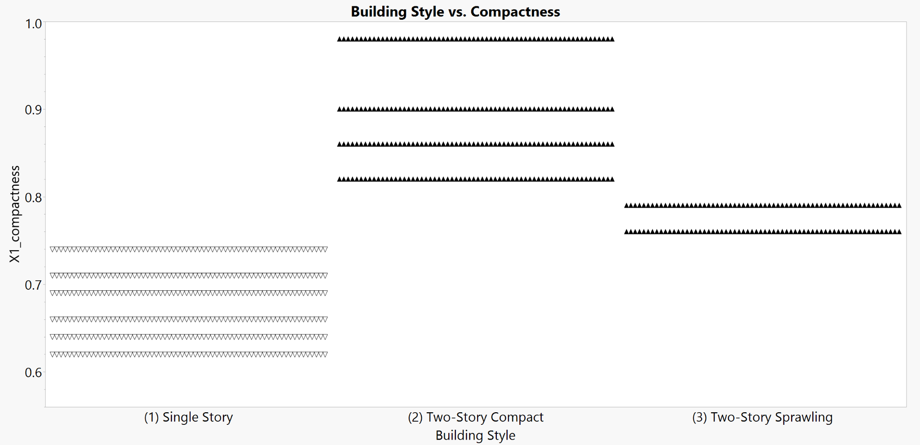
Cluster Analysis Model
Two-story buildings in cluster 2 have a smaller surface and wall area than the two-story buildings in cluster 3
cluster 2 is two-story buildings with a more compact floor plan
Single-story buildings in cluster 1 have a larger footprint than the other two clusters
single-story buildings spread outwards, not upwards
These area measurements are reflected in the compactness graph
single story buildings are less compact than two-story buildings

Slide 12
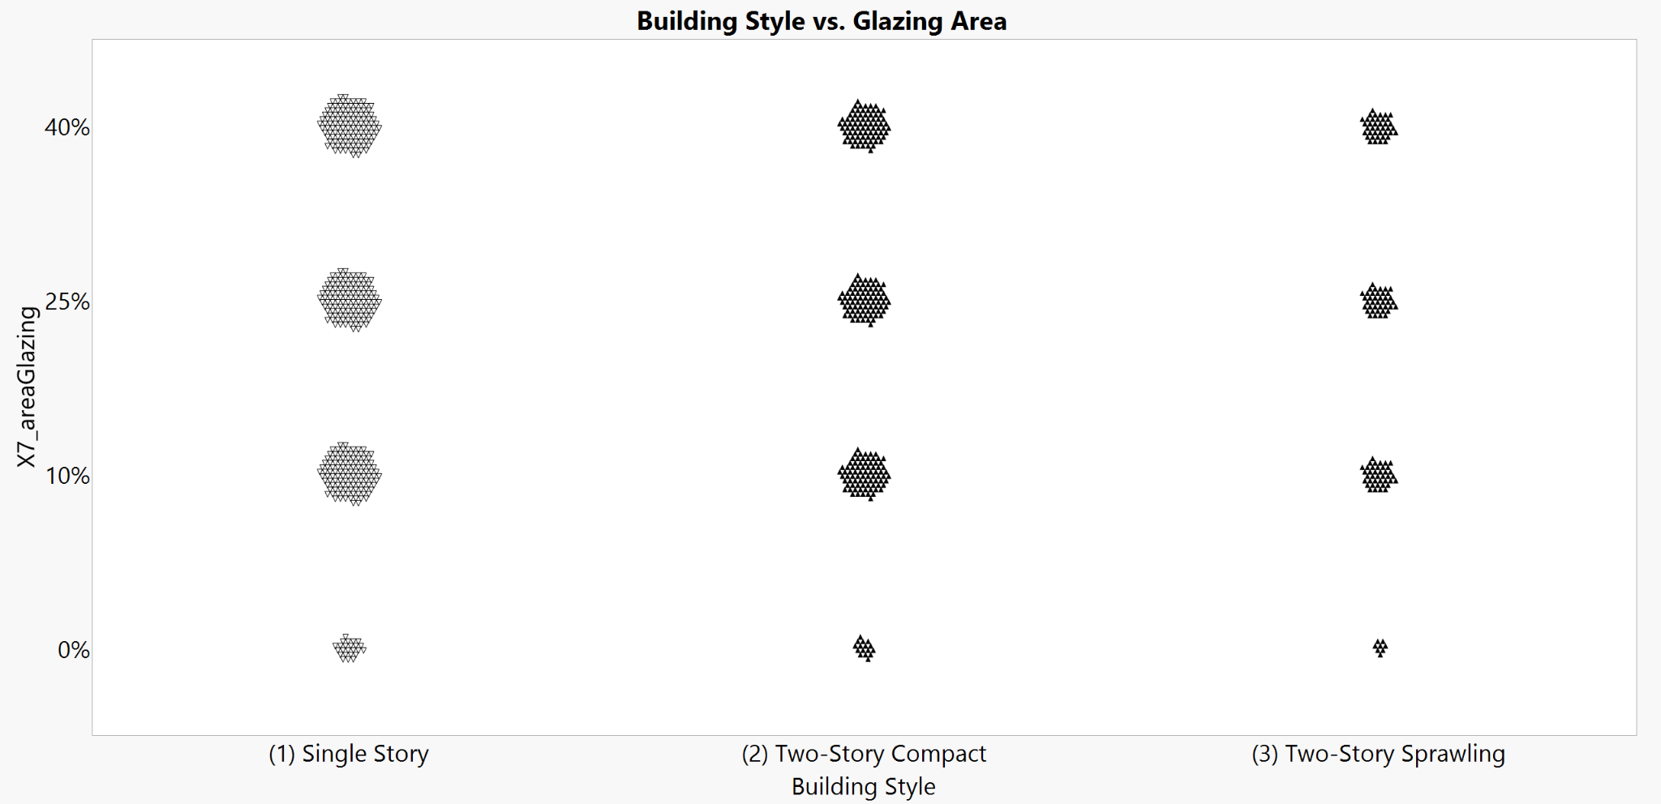
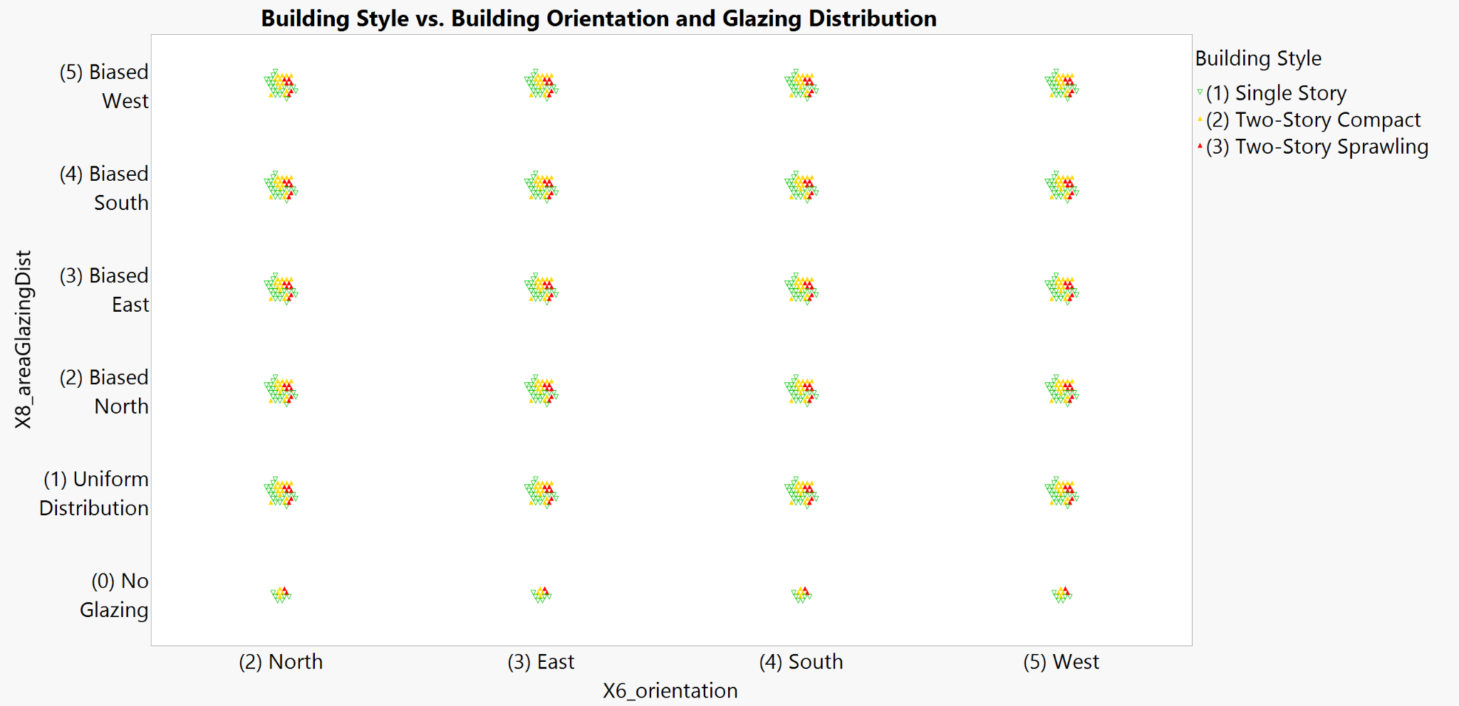
Cluster Analysis Model
There does not appear to be any variation between clusters with regard to building orientation, glazing area, nor glazing distribution.

Slide 13
Regression Analysis Model

Slide 14
Regression Analysis - Heating Loads
Variables Excluded (Due to insignificance or redundancy)
Building orientation – t(767df) = 0.0707, p = 0.9756
Surface area
Redundant with roof and wall area due to dataset being simulated / generated formulaically (X2_areaSurface = X3_areaWall + 2*X4_areaRoof)
Model Results
Explained Variance: 92.31%
Significant Predictors:
Glazing area – t(767df) = 19.78, p < 0.0001
Overall height – t(767df) = 12.93, p < 0.0001
Glazing distribution – t(767df) = 17.55, p < 0.0001
Relative compactness – t(767df) = -6.60, p < 0.0001
Roof area – t(767df) = -5.36, p < 0.0001
Wall area – t(767df) = -2.17, p = 0.0301

Slide 15
Regression Analysis - Heating Loads
Predictive Formula
Y1 (Heating Load) = 84.775
+ 16.848 * X7 (Glazing Area)
+ 4.170 * X5 (Height)
- 3.620 * X8[0] (No Glazing)
+ 0.908 * X8[1] (Uniform Glazing)
+ 0.816 * X8[2] (Glazing Biased North)
+ 0.563 * X8[3] (Glazing Biased East)
+ 0.769 * X8[4] (Glazing Biased South)
- 64.773 * X1 (Compactness)
- 0.027 * X4 (Roof Area)
- 0.175 * X4 (Wall Area)

Slide 16
Regression Analysis - Cooling Loads
Variables Excluded (Due to insignificance or redundancy)
Building orientation – t(767df) = 1.4047, p = 0.2402
Surface area
Redundant with roof and wall area due to dataset being simulated / generated formulaically (X2_areaSurface = X3_areaWall + 2*X4_areaRoof)
Glazing distribution orientation
Only the presence / absence of glazing predicts cooling loads, not the orientation
Model Results
Explained Variance: 88.68%
Significant Predictors:
Glazing area – t(767df) = 17.08, p < 0.0001
Overall height – t(767df) = 11.62, p < 0.0001
Relative compactness – t(767df) = -6.31, p < 0.0001
Roof area – t(767df) = -4.74, p < 0.0001
Wall area – t(767df) = -3.13, p = 0.0018

Slide 17
Regression Analysis - Cooling Loads
Predictive Formula
Y2 (Cooling Load) = 97.931
+ 13.253 * X7 (Glazing Area)
+ 4.284 * X5 (Height)
- 70.788 * X1 (Compactness)
- 0.176 * X4 (Roof Area)
- 0.044 * X4 (Wall Area)

Slide 18
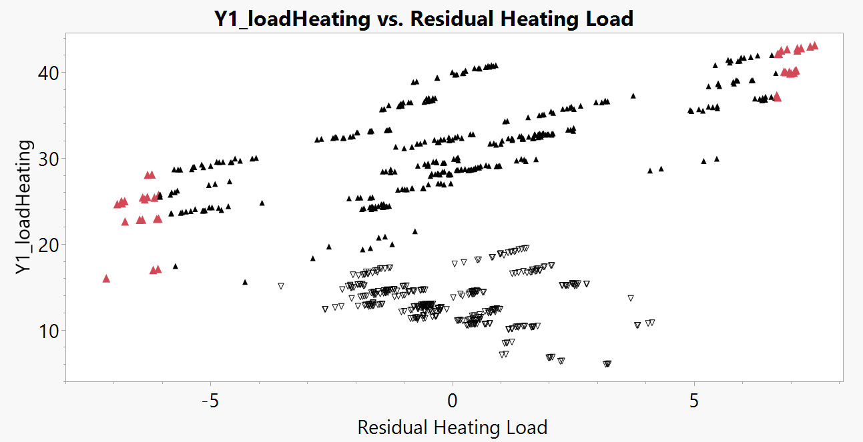
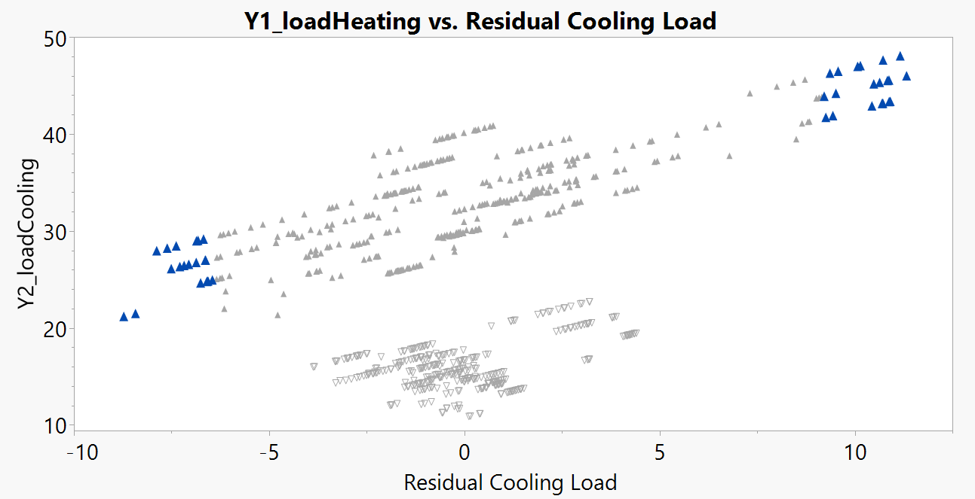
Over- & Under-Estimated Data Points
All outliers are two-story buildings.
No other discernible similarities between outliers.
Relatively uniformly distributed with regards to glazing area, orientation, etc.
6 buildings where both heating and cooling load were overestimated.
All the same structure, simply oriented in different directions.

Slide 19
Conclusions

Slide 20

Literature Comparison
The U.S. Department of Energy published a report in June of 2011 titled Strategy Guideline: Accurate Heating and Cooling Load Calculations.
Reviewed this report to compare our findings to what they published, as far as variables that impact heating and cooling loads and how this data is used within industry.
According to this report, the four variables that impact heating and cooling loads within structures include the location of the building, specific design conditions within the interior of the building, the orientation, and how the building is constructed.

Slide 21
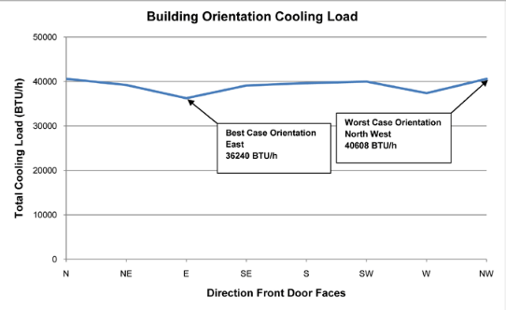
Literature Comparison
Through our data analysis, orientation did not strongly predict heating and cooling loads. While reviewing the report published by the U.S. Department of Energy, orientation did have an impact on the amount of heat a house would increase by, depending on other factors such as window placement on particular faces of the structure.
Their findings show that the total cooling load fluctuated about 12% from its highest to lowest point. This is interesting, since we didn’t find orientation to be a strong predictor.
There is little fluctuation, which would substantiate our findings.
Burdick, Arlan. Strategy Guideline: Accurate Heating and Cooling Load Calculations. June 2011. National Renewable Energy Laboratory, www.nrel.gov/docs/fy11osti/51603.pdf.

Slide 22
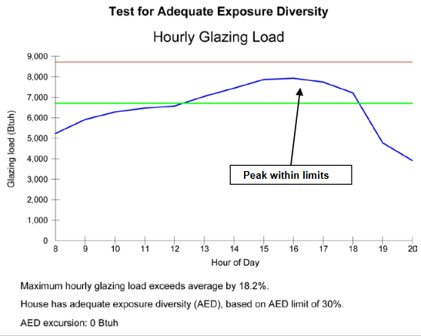
Literature Comparison
Per the data published, the glazing load fluctuated by 100% throughout the course of the day. We showed that glazing distribution significantly impacts the heating and cooling load.
This data supports our findings, since there seems to be a significant impact on the glazing load, by each hour of the day.
The other variables that were outlined in this report had more to do with the construction materials, rather than surface area, which were the variables that were analyzed in our studies.
Burdick, Arlan. Strategy Guideline: Accurate Heating and Cooling Load Calculations. June 2011. National Renewable Energy Laboratory, www.nrel.gov/docs/fy11osti/51603.pdf.

Slide 23
Managerial Insights
Key Influencers of Energy Loads
Building Height – Taller buildings experience greater thermal loads due to increased surface area exposure and stack effects, raising heating requirements.
Glazing Area – Larger windows increase cooling loads via solar heat gain, while poor insulation can exacerbate energy loss in both heating and cooling.
Wall Area and Insulation – Walls with significant surface areas impact energy consumption through heat gain or loss depending on seasonal conditions.
Strategies for Energy Efficiency
Incorporate energy-efficient glazing technologies (e.g., double glazing, low-emissivity coatings).
Design buildings with optimal height and compactness to balance thermal loads.
Utilize shading features and high-quality insulation to mitigate energy consumption.

Slide 24
Lessons Learned
Challenges Encountered
Complexity in analyzing the influence of orientation and glazing distribution required careful interpretation.
Highlighted the importance of data cleaning, model selection, and validation through cross-referencing existing studies.
Broader Lessons
A data-driven approach is essential for sustainable and efficient design decisions.
Actionable insights can drive real-world benefits, even in complex systems.

Slide 25
Citations
Burdick, Arlan. Strategy Guideline: Accurate heating and cooling load calculations. No. NREL/SR-5500-51603; DOE/GO-102011-3304. National Renewable Energy Lab.(NREL), Golden, CO (United States), 2011. https://www.nrel.gov/docs/fy11osti/51603.pdf.
Tsanas, Athanasios, and Angeliki Xifara. Accurate quantitative estimation of energy performance of residential buildings using Statistical Machine Learning Tools. Energy and Buildings, vol. 49, June 2012, pp. 560–567, https://doi.org/10.1016/j.enbuild.2012.03.003.

